Slide 1

Magic 8 Ball
Demystifying Machine Learning
Final Project Group:
Moutsaem Akkad
Krystal Briggs
Gan Jin
Jihan McKenzie
Denise Person
Rachel Song
October 5th, 2019

Slide 2
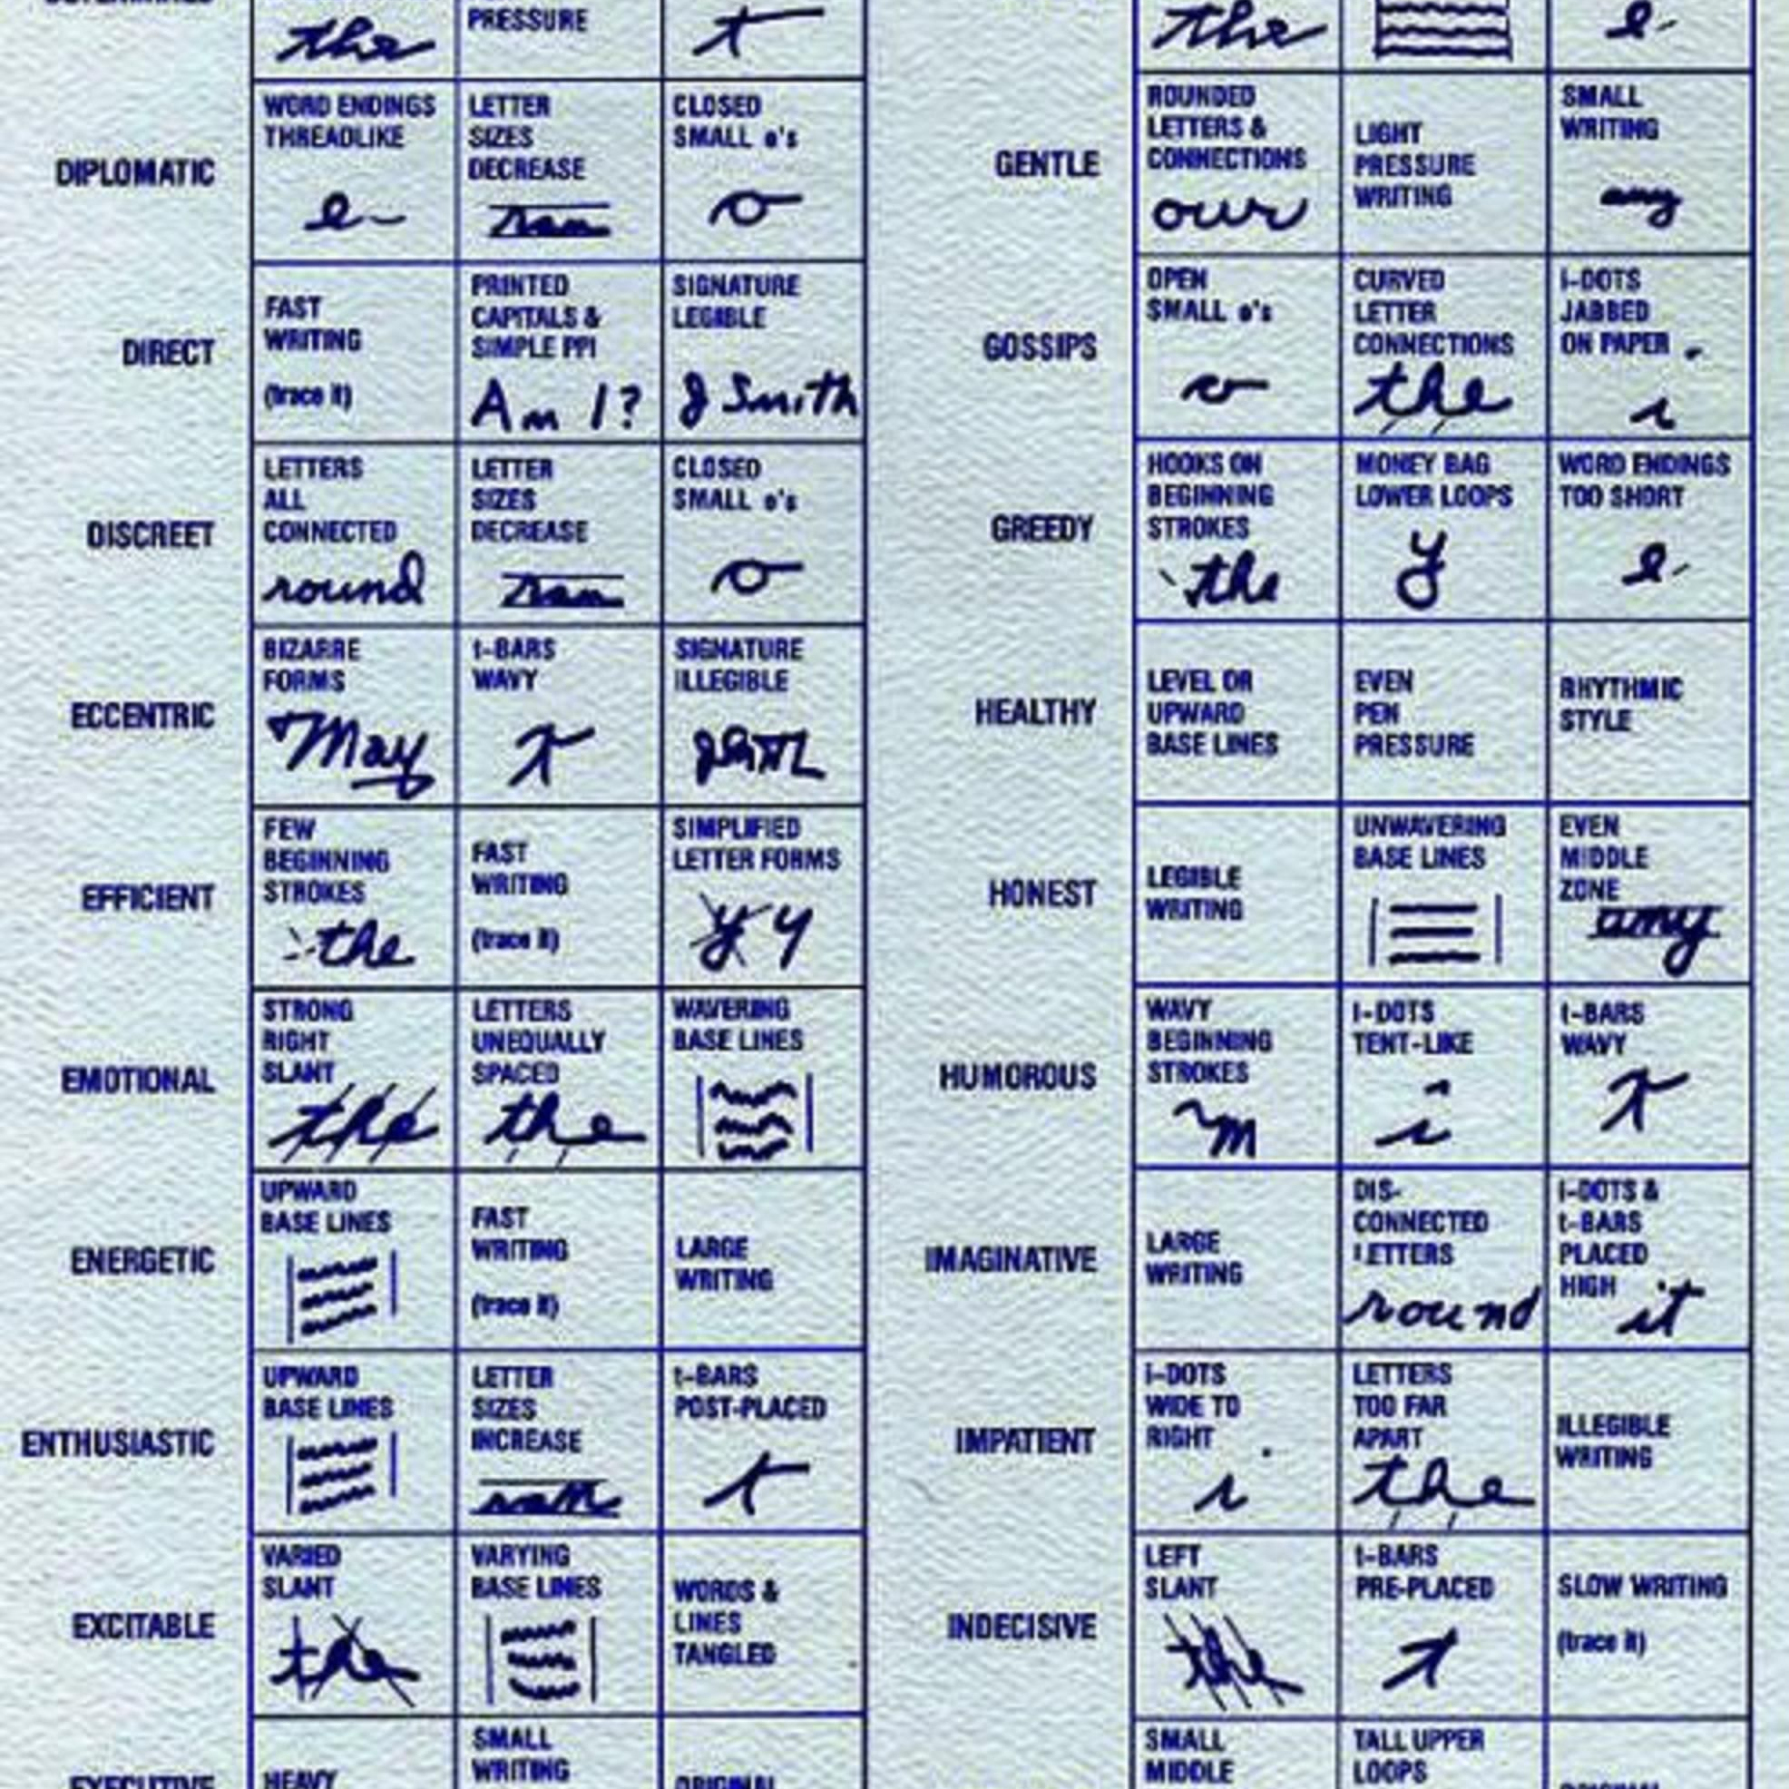
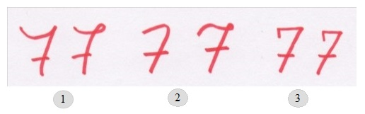
Graphology
“Graphology is the analysis of the physical characteristics and patterns of handwriting claiming to be able to identify the writer, indicating the psychological state at the time of writing, or evaluating personality characteristics. It is generally considered a pseudoscience.”
https://en.wikipedia.org/wiki/Graphology
Notes:
- Example of USPS

Slide 3
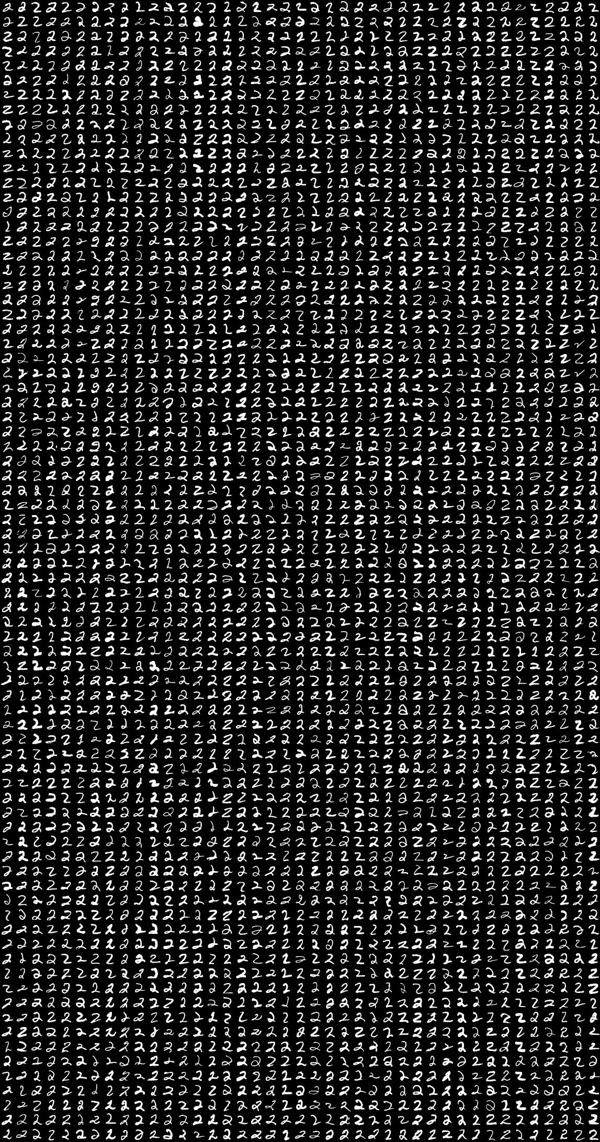
Project Proposal:
Create a user interactive interface that utilizes deep learning models to identify handwritten numbers and uppercase letters in the alphabet

Slide 4

Tools and Libraries
DATA
HTML/CSS/Bootstrap
JavaScript D3.js
Flask server
Google API
Heroku
Libraries:
Keras
Python Pandas
Python Matplotlib
Numpy
Scikit-Learn
OS
Seaborn
Pillow
Base 64

Slide 5
Web Page
User interactive driven input onto canvas
User submits input
Flask
Prediction
Load image into model prediction
In Flask, convert back into image
Convert image back to pixels
Return prediction to web page
Javascript
Convert image to base 64 in Javascript
Create connection to Flask to predict endpoint
Project Steps

Slide 6
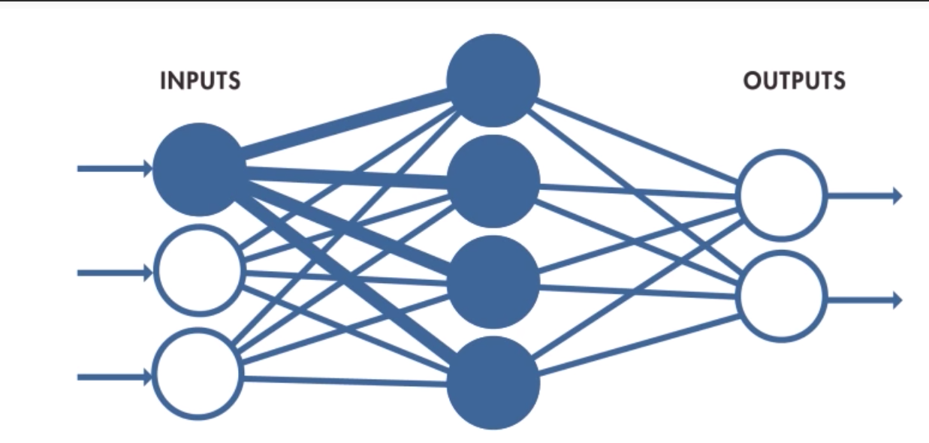
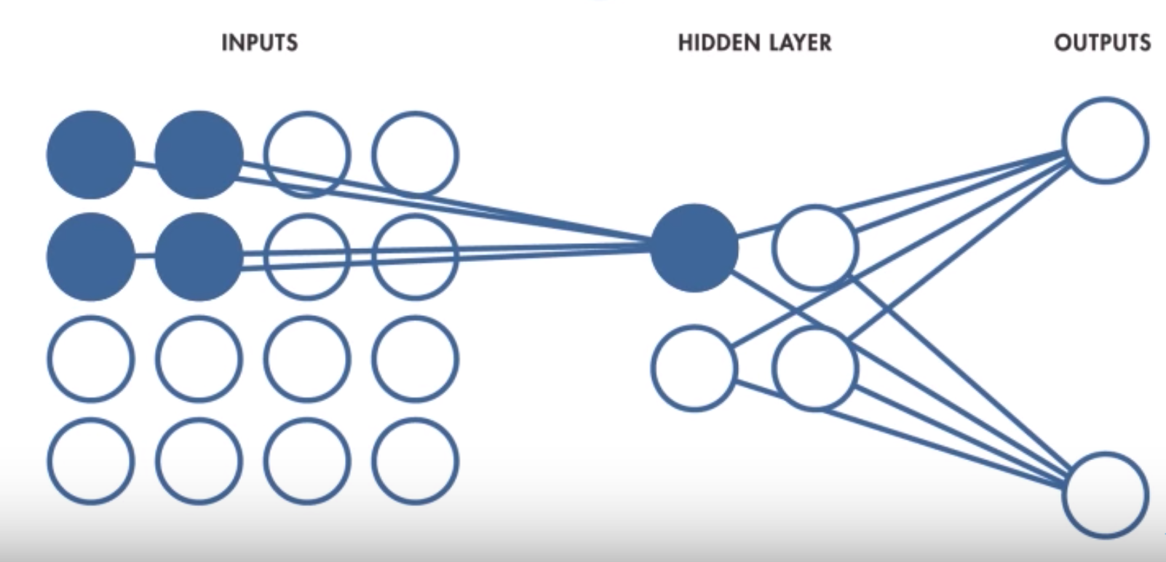
Neural Network
Convolutional Neural Network
Looks at every pixel individually
Vectorize each square (make it as a column) and feed that line to NN; in our case, 784
Looks at pixels in groupings
28 x 28 greyscale pixels
Learns directly from images
CNN is better for image recognition
Accurate pattern detection

Slide 7
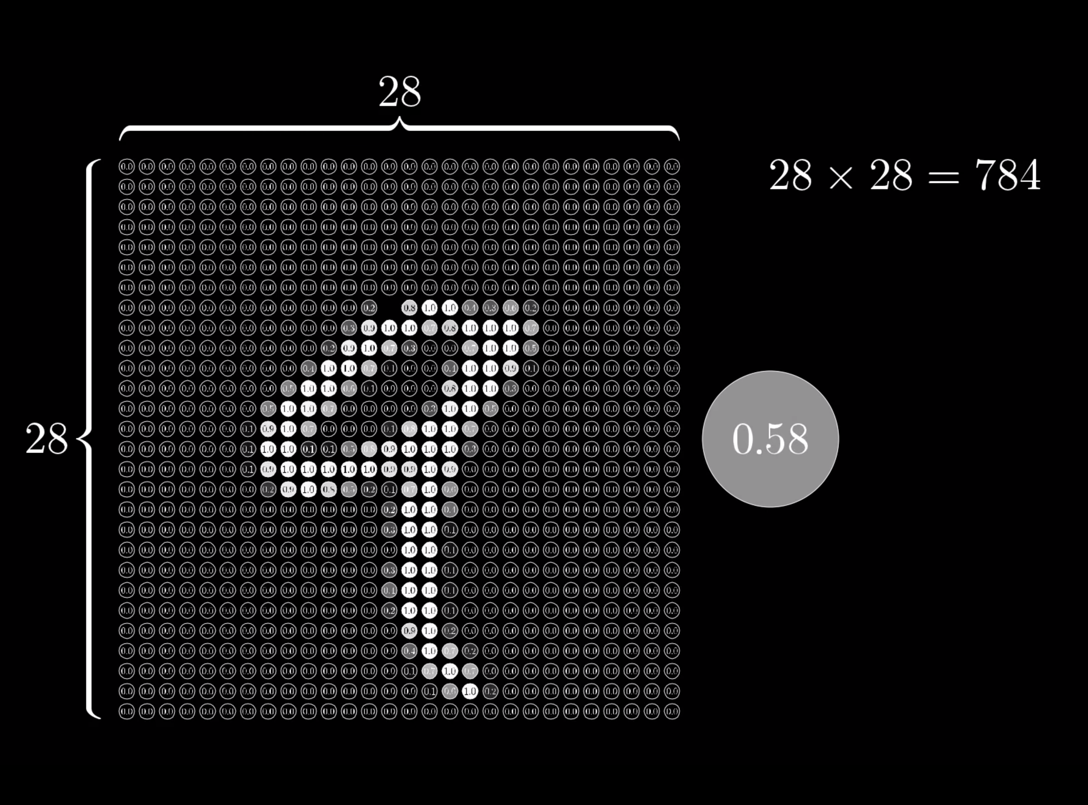
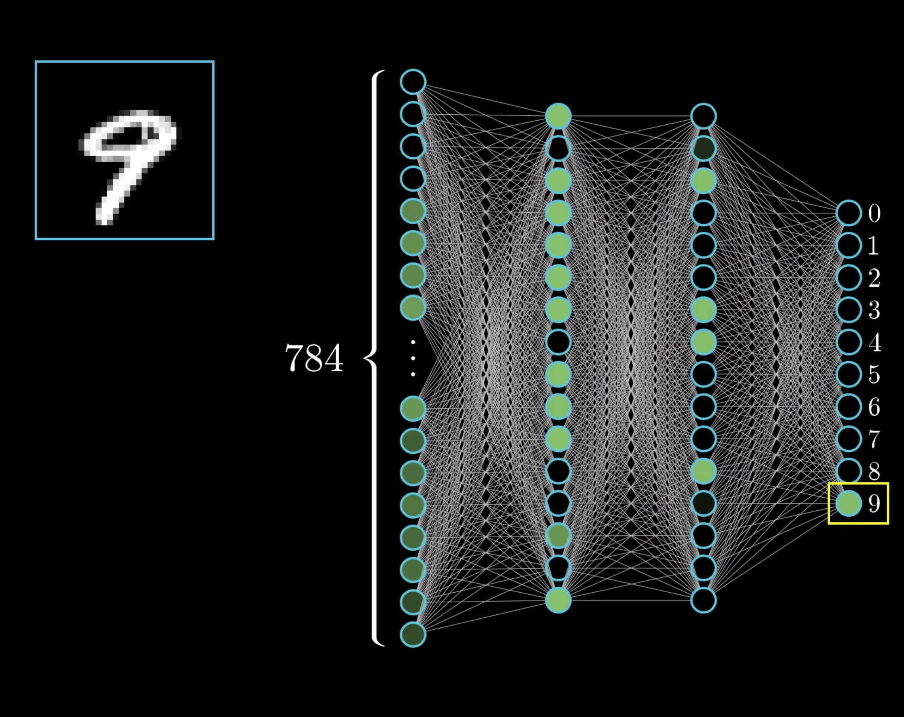

Slide 8
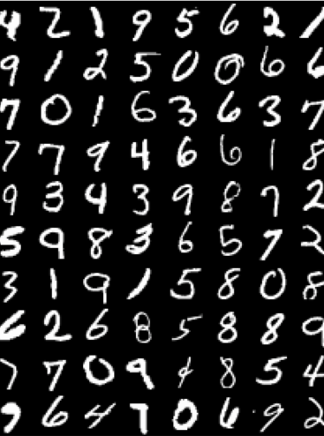
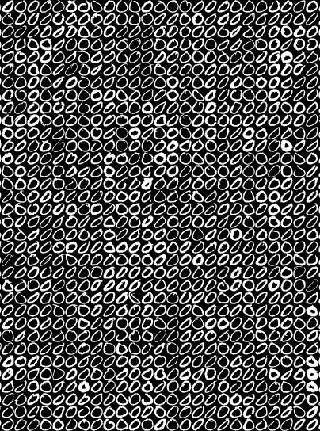
Dataset
Data is extracted from the Modified National Institute of Standards and Technology (MNIST) Database
The datasets contains handwritten digits and letters that are used to train image processing systems
Dataset contains:
Digits (http://yann.lecun.com/exdb/mnist/)
Alphabet (https://www.kaggle.com/sachinpatel21/az-handwritten-alphabets-in-csv-format)
Greyscale images (28x28 pixels)
MNIST

Slide 9
Jupyter Notebook Review
(Code Explained)

Slide 10
Flask
Flask Application used to serve backend server; render template function to render html page.
Steps
Load model prediction.
Execute /predict() route to make a prediction of user’s hand drawn image.
Get base64 format of user drawn image passed into /predict() route.
Process image before feeding into prediction model:
Decode image from base64 to image.
Format image according to dataset (resize, reshape, flatten convert to 4D tensor).
Convert image to numpy array.
Perform prediction running image array through trained model model.predict() function.
Map result to its value.
Return map result in json format

Slide 11
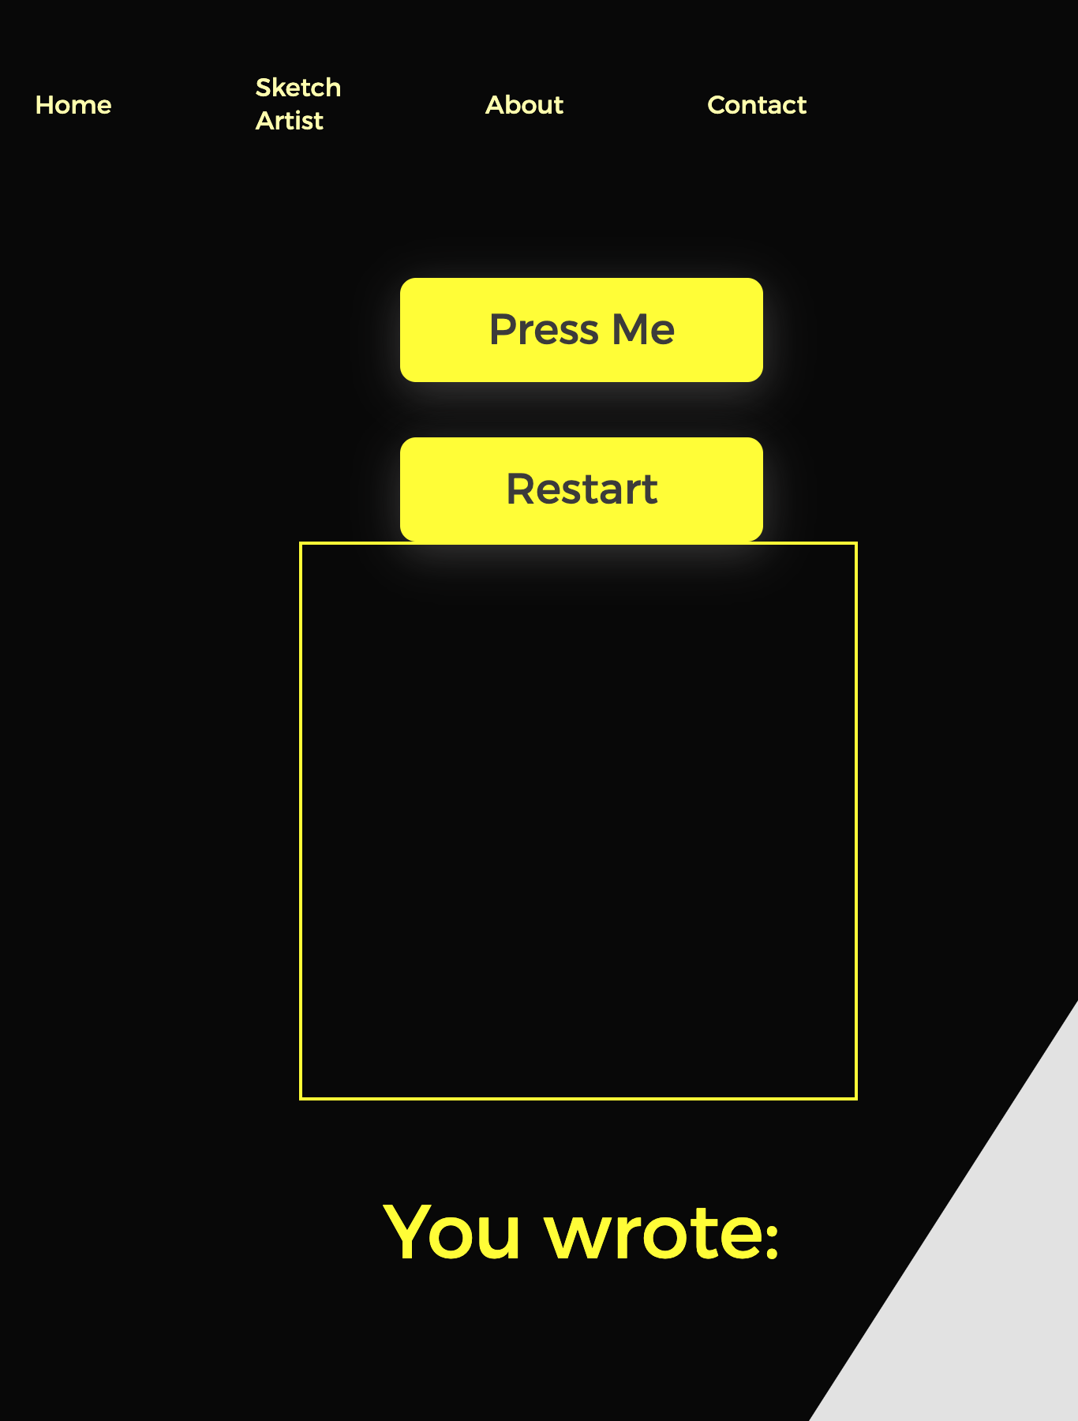
JavaScript
Create a canvas for user interaction - Add event listener (mouse move, mouse down, mouse up, and mouse out) - Find the coordinate when mouse is down - Draw lines when mouse is move - Stop drawing when mouse is up or out
Define a function to send image to flask route - Convert image to base64 - Use fetch() method to post base64 to /predict route - Take the prediction from /predict route and update the html
Add restart button to reload the webpage

Slide 12
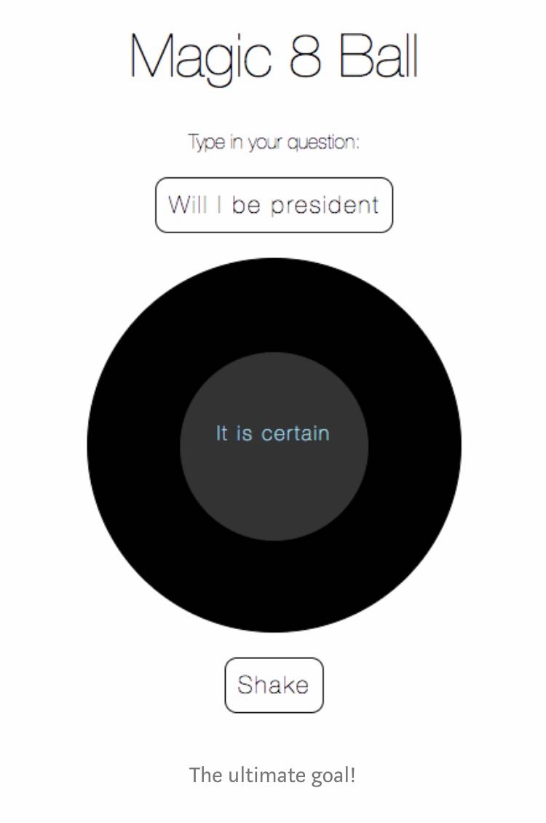
HTML Design
Design was constructed using “Google Fonts API,” to create unique fonts for the web page.
A Google API link was used to add a special stylesheet link to the HTML document. The font was then referred to in CSS style.
CSS design was purposely created to be simple so that the user interaction would be the main highlighted effect for the website.
Black and White design was constructed in order to mimic the colors of the “Magic 8 Ball.”
Main objective was to make it look like an interactive game for individuals school age and up to enjoy.

Slide 13
Thank you!
Questions?

Slide 14
Resources
Dataset:
http://yann.lecun.com/exdb/mnist/
https://www.kaggle.com/sachinpatel21/az-handwritten-alphabets-in-csv-format
PowerPoint template:
https://powerpointify.com/hipster-free-powerpoint-template/
https://www.youtube.com/watch?v=aircAruvnKk

